Slide 1
Contraband to Freedmen: “How the Law of War Became a Tool for Liberty”
Hari Jones, Curator
African American Civil War Museum
Washington, DC

Slide 2
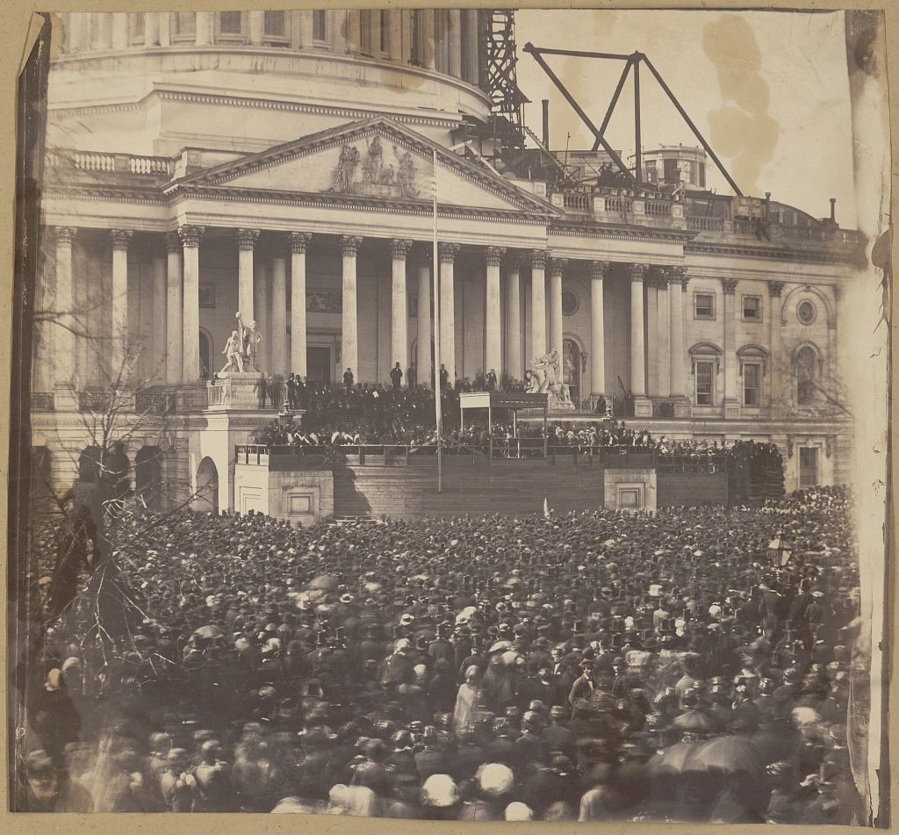

Slide 3
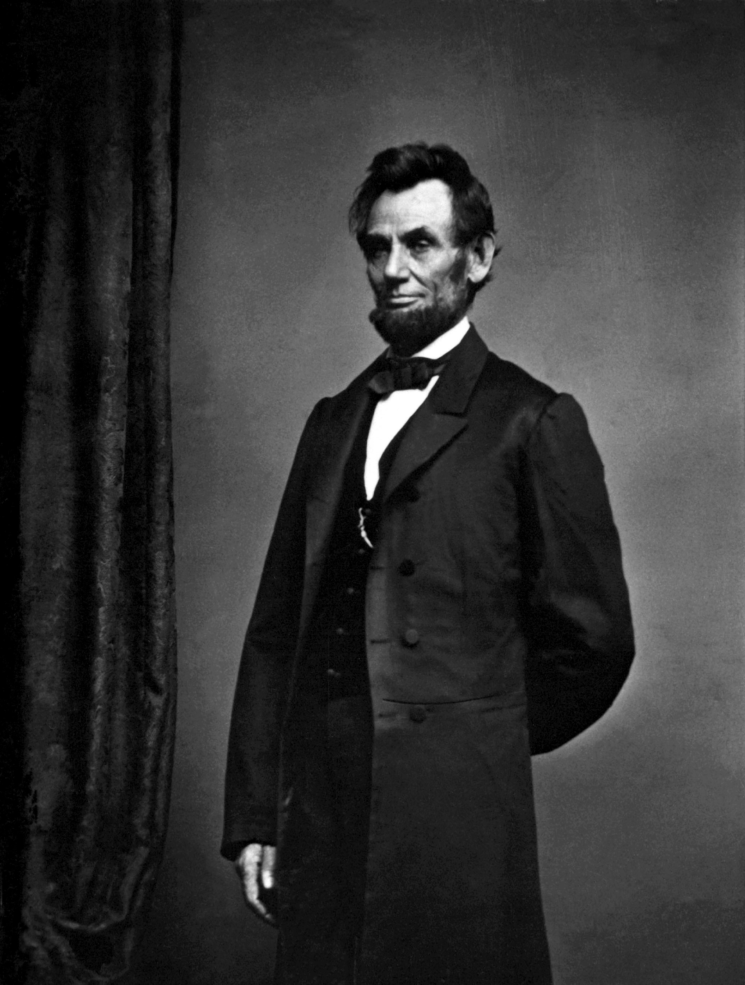

Slide 4
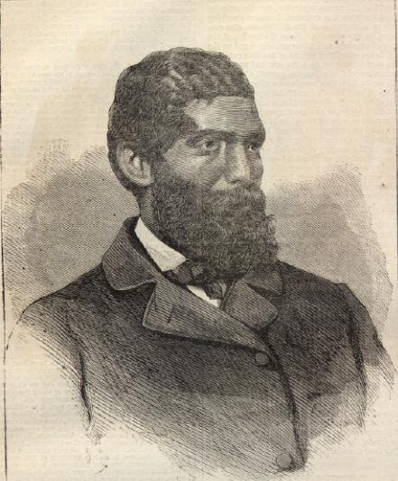
Sooner or later the clashing of arms will be heard in this country, and the black man’s services will be needed: 150,000 freemen capable of bearing arms, and not all cowards and fools, and three quarter a million slaves, wild with the enthusiasm caused by the dawn of the glorious opportunity of being able to strike a genuine blow for freedom, will be a power which the white man will be “bound to respect.” Will the blacks fight? Of course they will.
March 5, 1858
Dr. John S. Rock
Notes:
4
4

Slide 5
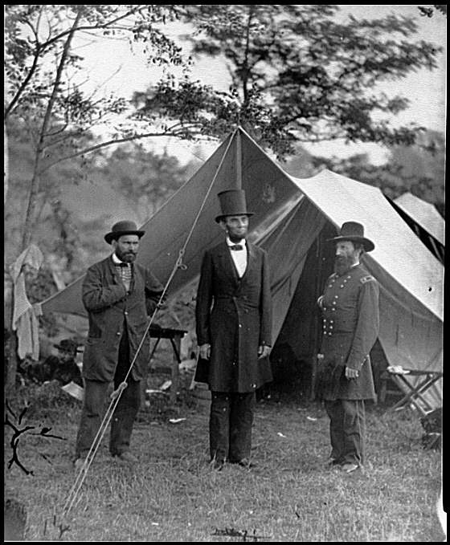
“Although as yet prevented from taking up arms in defense of their rights, these colored men had banded themselves together to further the cause of freedom, to succor the escaping slave, and to furnish information to loyal commanders of the movements of the rebels, as far as they could be ascertained.”
Allan Pinkerton,
Head of Union Intelligence 1861 -1862
Pinkerton

Slide 6
The Loyal League
AKA:
The Legal League
Lincoln’s Legal Loyal League
(or the 4Ls)
Notes:
6

Slide 7
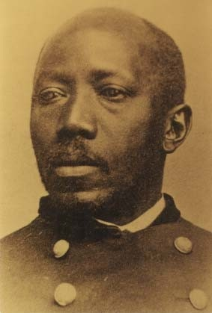
We are able sir, to command all the effective black men, as agents, in the United States.
Dr. Martin R. Delany

Slide 8
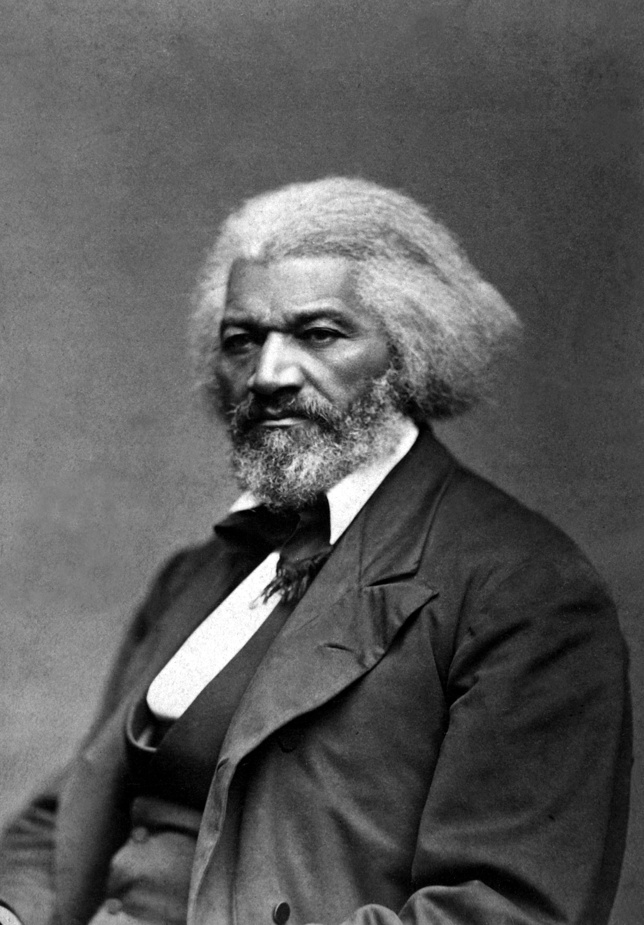
We are happy to believe - indeed, we have very good evidence to the fact - the Administration in Washington, notwithstanding appearances, stand ready to inaugurate and carry out a policy towards slavery which will most certainly eventuate in breaking down slavery in all the rebel States, just as soon as the people require it.
Frederick Douglass, August 1861
Notes:
8
8

Slide 9
Governor Patrick Henry

Slide 10
From the instant that your Slave-holding States become the theatre of War – civil, servile, or foreign – from that instant, the War powers of Congress extend to interference with the Institution of Slavery in every Way by which it can be interfered with.
John Quincy Adams, May 25, 1836

Slide 11
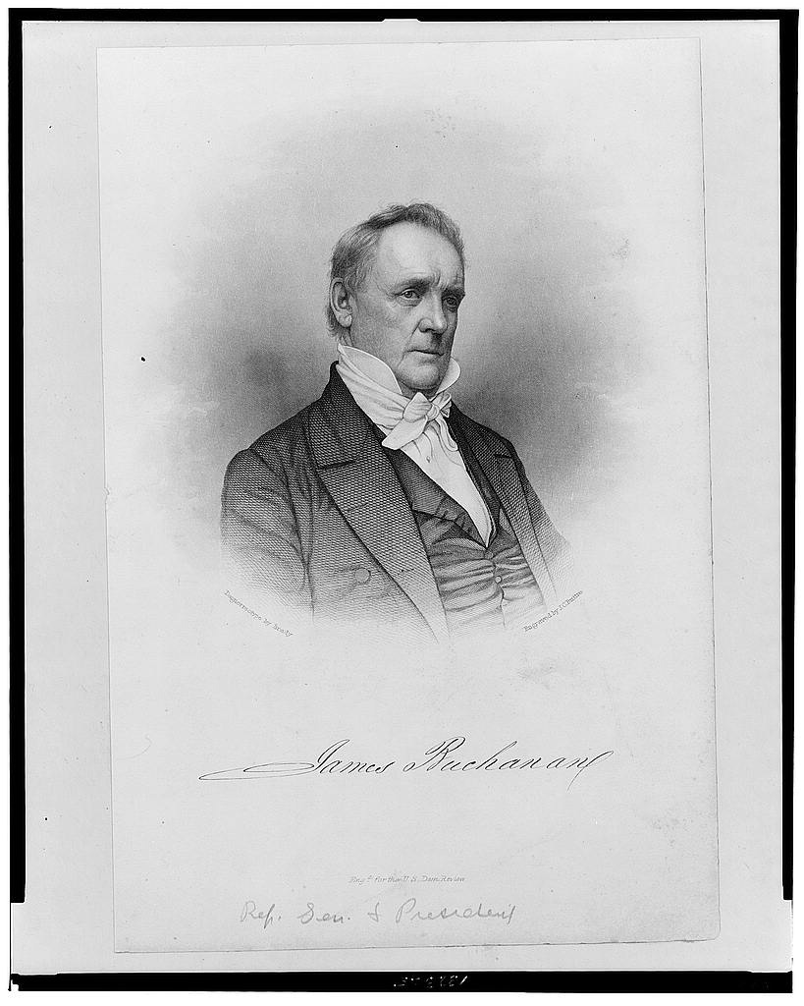

Slide 12
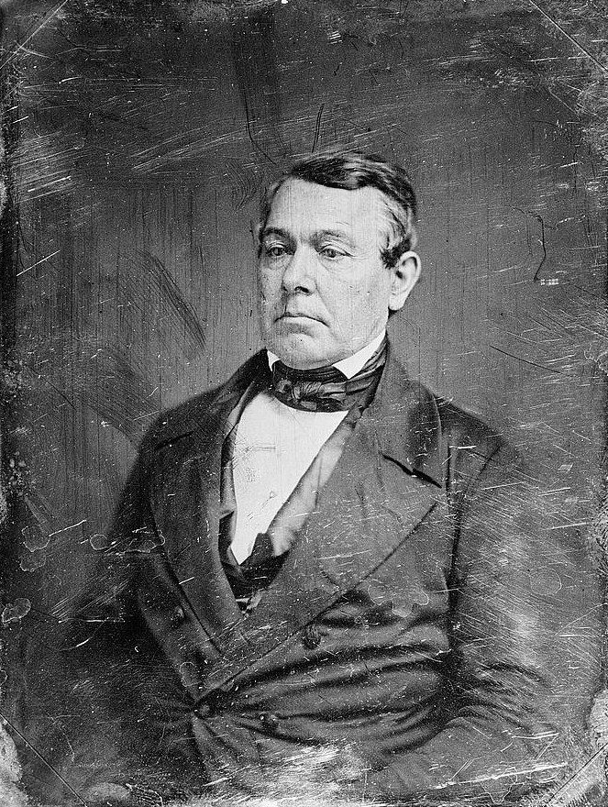
Representative Thomas Corwin, a Republican from Ohio, was the
chairman of the
Special Committee of Thirty-three, which drafted Buchanan’s 13th Amendment to the Constitution in 1861.

Slide 13
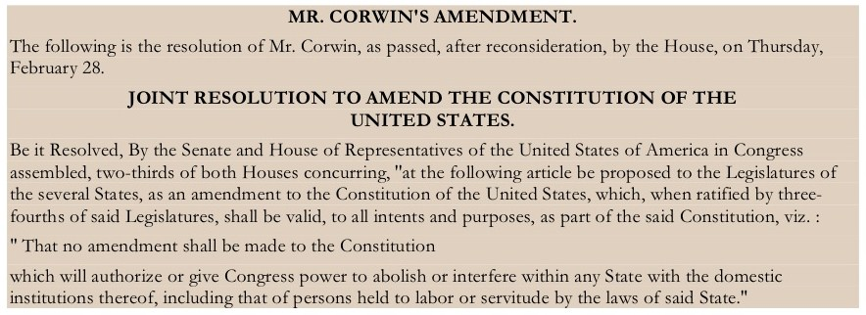

Slide 16
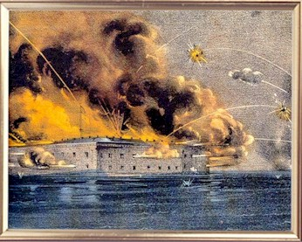
April 12, 1861

Slide 17
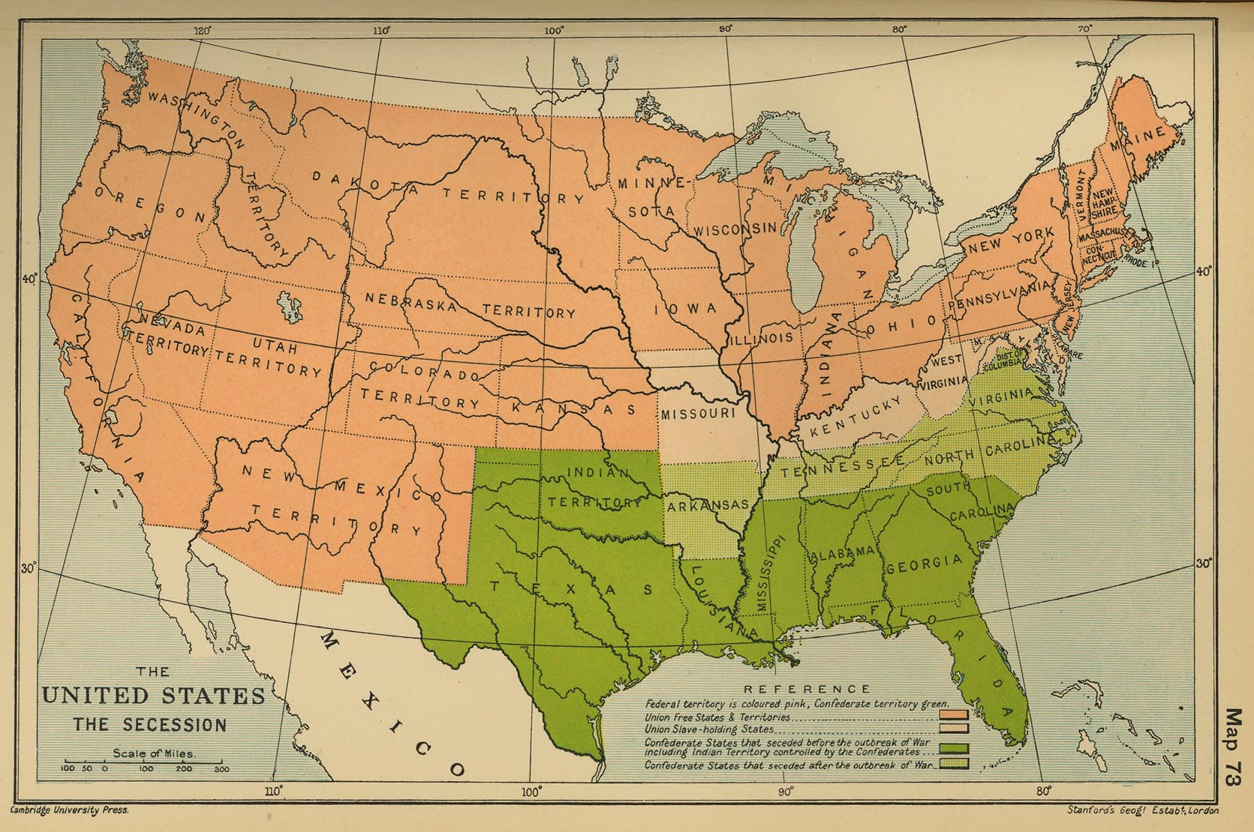
April 19: Lincoln calls for 75,000 volunteers from the states
May 3: Lincoln lifts the writ of habeas corpus

Slide 18
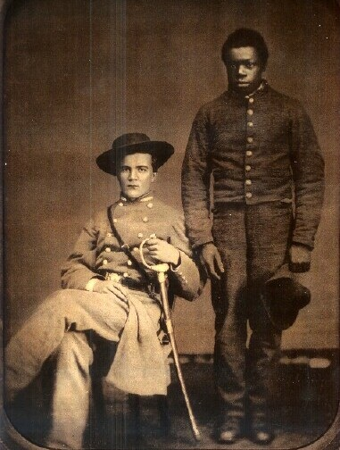

Slide 19
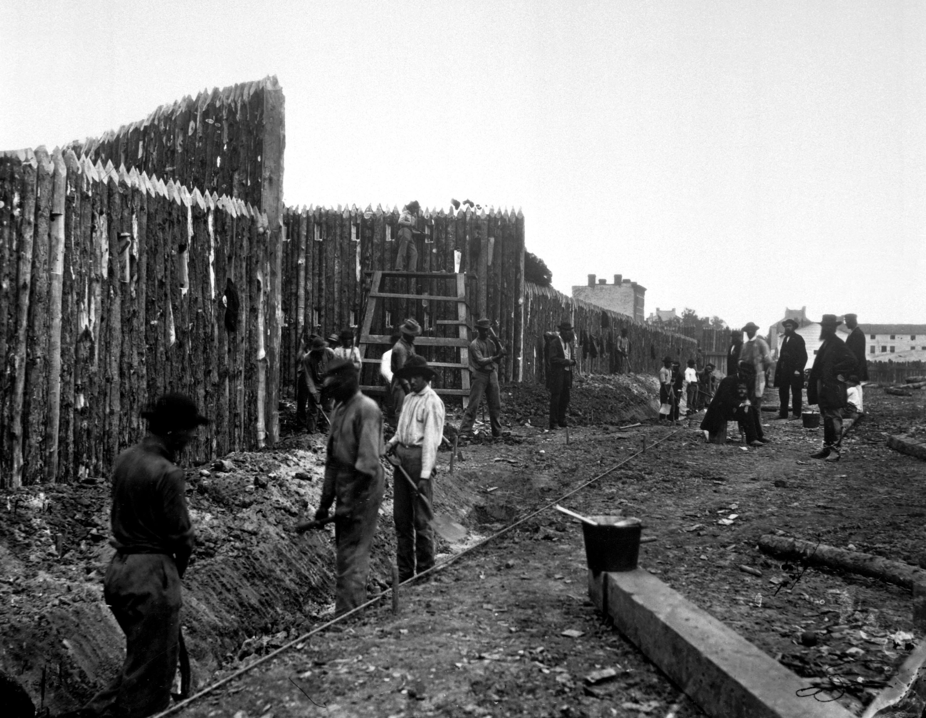

Slide 20
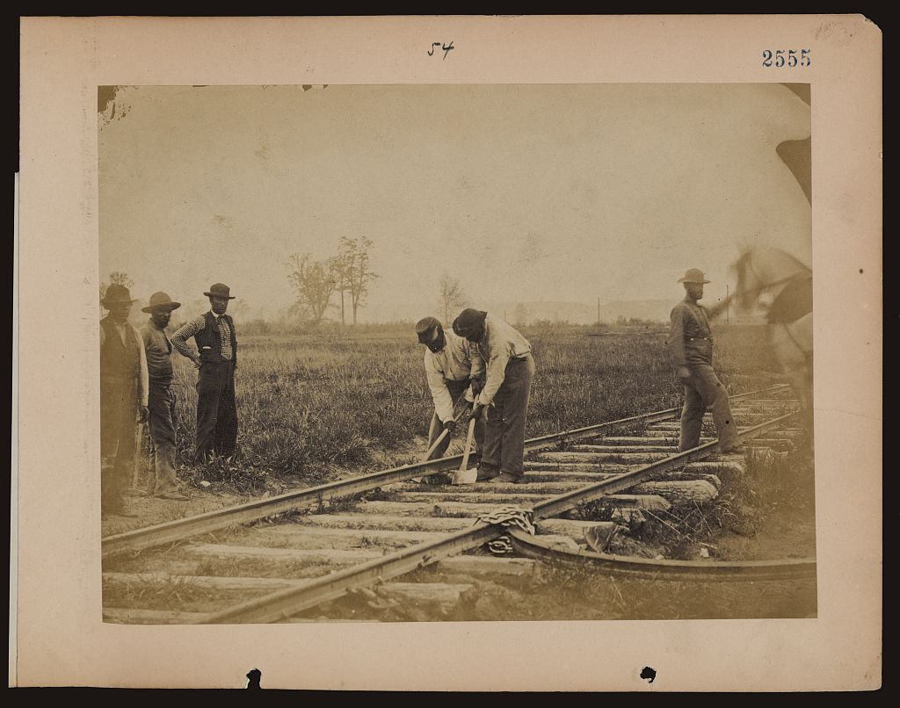

Slide 21
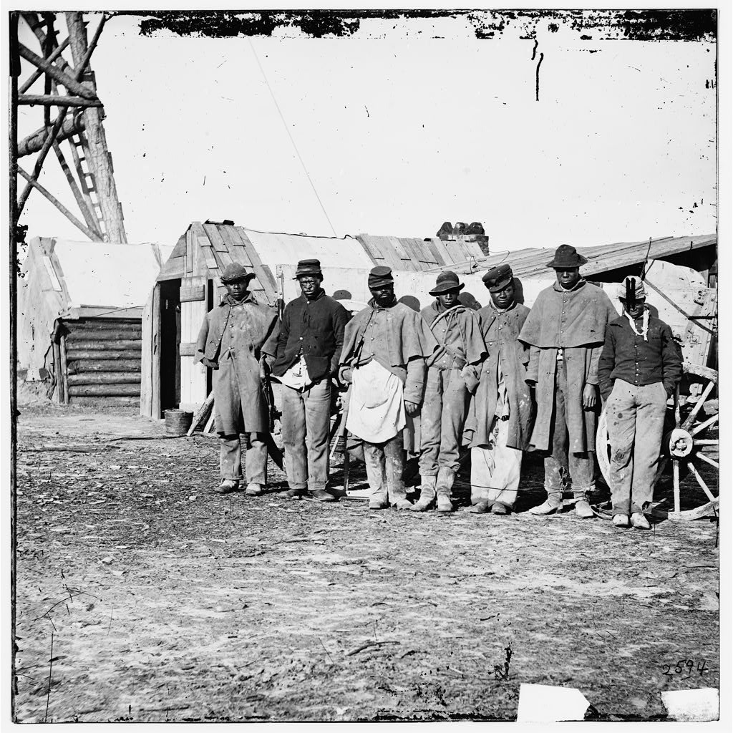

Slide 22
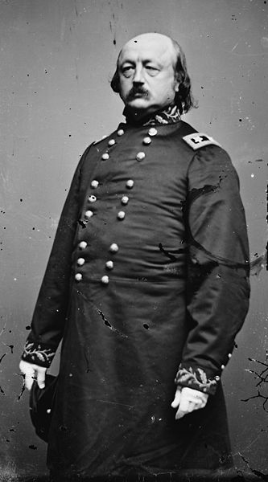
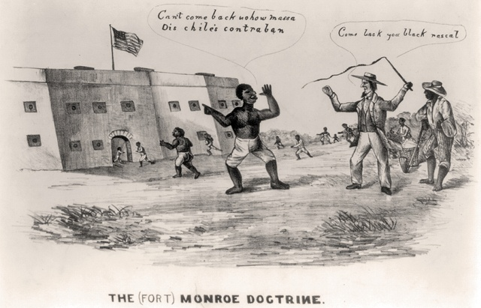
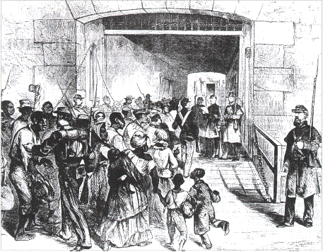
General Benjamin Butler
Frank Baker
James Townsend Sheppard Mallory

Slide 23
“I am informed,” said Major Carey, that three negroes belonging to Colonel Mallory have escaped within your lines. I am Colonel Mallory’s agent and have charge of his property. What do you mean to do with those negroes.”
“I intend to hold them,” said I.
“Do you mean, then, to set aside your constitutional obligation to return them?”
“I mean to take Virginia at her word, as declared in the ordinance of secession passed yesterday. I am under no constitutional obligation to a foreign country, which Virginia now claims to be.”
“But you say we cannot secede,” he answered, “and so you cannot consistently detain the negroes.”
“But you say you have seceded, so you cannot consistently claim them. I shall hold these negroes as contraband of war, since they are engaged in the construction of your battery and are claimed as your property. The question is simply whether they shall be used for or against the Government of the United States. Yet, though I greatly need the labor which has providentially come to my hands, if Colonel Mallory will come into the fort and take the oath of allegiance to the United States, he shall have his negroes, and I will endeavor to hire them from him.”

Slide 24
The question is simply whether they shall be used for or against the Government of the United States.

Slide 26
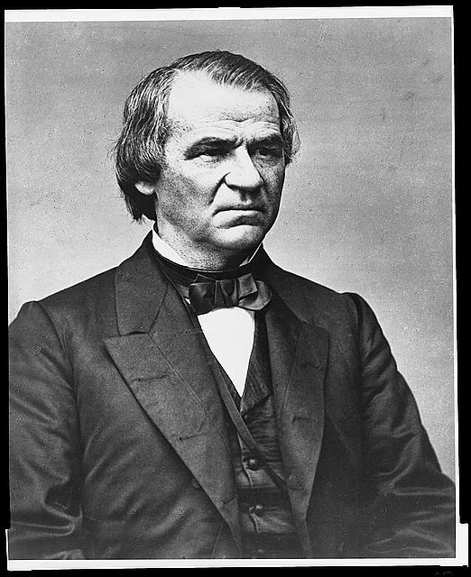
Senator
Andrew Johnson
(D) Tennessee

Slide 27
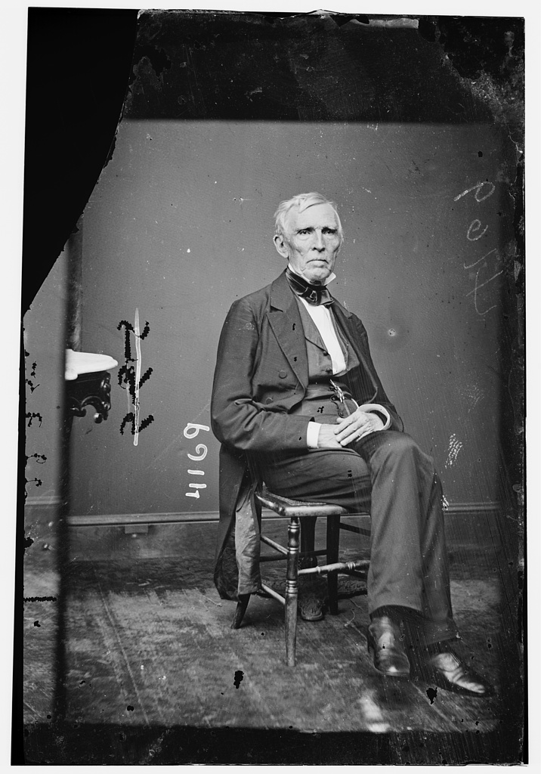
Representative
John J. Crittenden
(U) Kentucky

Slide 28
US Congress passes resolutions stating the “Object of the War”: “…to maintain the supremacy of the Constitution and to preserve the Union and not to overthrow or interfere with the institutions of the states.”

Slide 29
July 15, 1861
Senator Lyman Trumbull introduced a bill (S. No. 25) to confiscate property used for insurrectionary purposes.

Slide 30
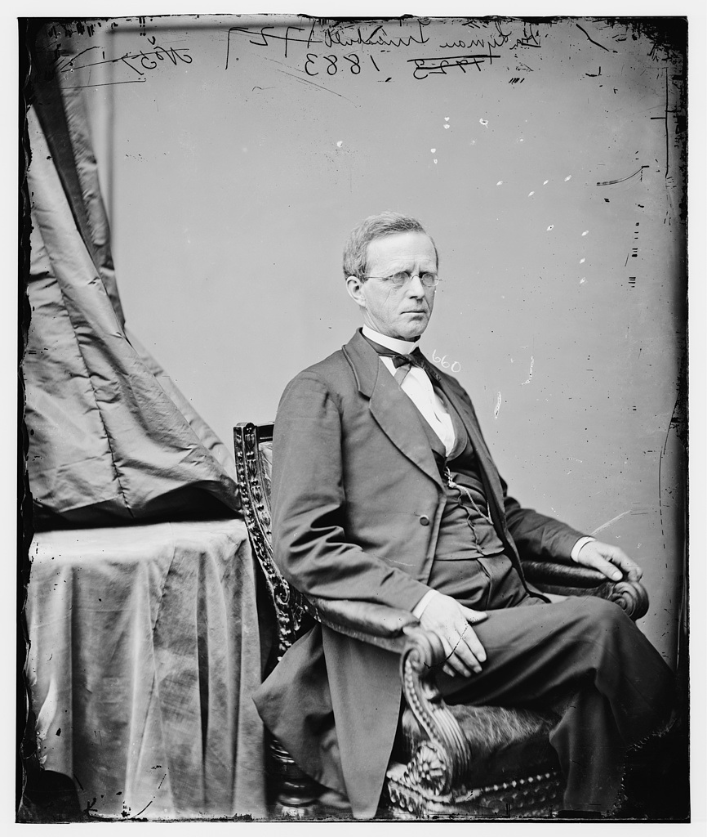
I understand that negroes were in the fight that recently occurred [1st Battle of Bull Run]. I take it that negroes who are used to destroy the Union, and shoot down the Union men with the consent of traitorous masters, ought not to have them restored to them.
Senator
Lyman Trumbull
(R) Illinois

Slide 31
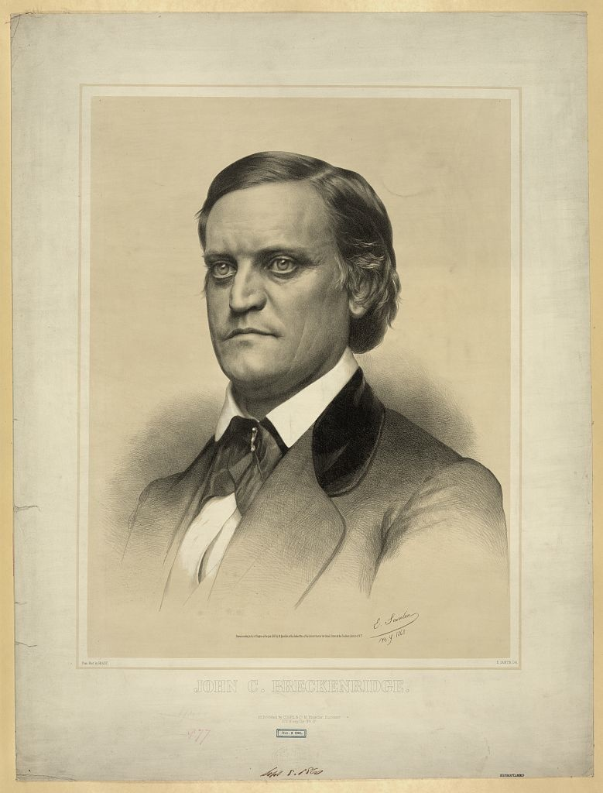
In my opinion, the amendment will be one of a series which will amount, before we are done with it – if, unhappily, we have no settlement and adjustment soon – to a general confiscation of all property, and a losing of all bonds.
Senator
John Breckenridge
(U) Kentucky

Slide 32
You cannot make a general law that regulates slavery, that shall regulate the rights of masters or the rights of the servant in a State in this Union, in time of peace… Now I ask my friend is this bill not getting around that, making use of the state of war, of a state of things that highly excites us all?
Representative
John J. Crittenden
(U) Kentucky

Slide 33
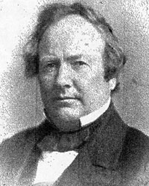
I have endeavored by my amendment so to modify the bill that shall be understood by the country as not affecting the institution of slavery in the States.
Representative
William Kellogg
(R) Illinois

Slide 34
First Confiscation Act
SEC. 4. And be it further enacted, That whenever hereafter, during the present insurrection against the Government of the United States, any person claimed to be held to labor or service under the law of any State, shall be required or permitted by the person to whom such labor or service is claimed to be due, or by the lawful agent of such person, to take up arms against the United States, or shall be required or permitted by the person to whom such labor or service is claimed to be due, or his lawful agent, to work or to be employed in or upon any fort, navy yard, dock, armory, ship, entrenchment, or in any military or naval service whatsoever, against the Government and lawful authority of the United States, then, and in every such case, the person to whom such labor or service is claimed to be due shall forfeit his claim to such labor, any law of the State or of the United States to the contrary notwithstanding. And whenever thereafter the person claiming such labor or service shall seek to enforce his claim, it shall be a full and sufficient answer to such claim that the person whose service or labor is claimed had been employed in hostile service against the Government of the United States, contrary to the provisions of this act.

Slide 35
First Confiscation Act
SEC. 4. …
to work or to be employed in or upon any fort, navy yard, dock, armory, ship, entrenchment, or in any military or naval service whatsoever, against the Government and lawful authority of the United States, then, and in every such case, the person to whom such labor or service is claimed to be due shall forfeit his claim to such labor, any law of the State or of the United States to the contrary notwithstanding.

Slide 36
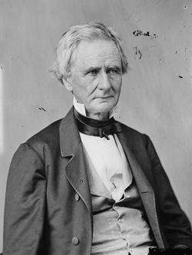
It is vain and idle for the Government to carry on this war, or hope to maintain its existence against rebellious force, without employing all the rights and powers of war. As has been said, the right to deprive the rebels of their property in slaves and slave labor is as clear and absolute as the right to take forage from the field, or cotton from the warehouse, or powder and arms from the magazine.
Simon Cameron, Secretary of War
December 1861

Slide 37
If it shall be found that the men who have been held by Rebels as Slaves, are capable of bearing arms and performing efficient Military service, it is the right, and may become the duty, of this Government to arm and equip them, and employ their services against the Rebels, under proper Military regulations, discipline, and command.
Simon Cameron, Secretary of War,
December 1, 1861

Slide 38
The United States ought to co-operate with any State which may adopt gradual abolishment of Slavery, giving State pecuniary aid, to be used by such State in its discretion, to compensate for the inconveniences, public and private, produced by such change of system.
President’s Message to Congress, March 6, 1862
President Abraham Lincoln

Slide 39
An Act to make an additional Article of War.
Article –. All officers or persons in the military or naval service of the United States are prohibited from employing any of the forces under their respective commands for the purpose of returning fugitives from service or labor, who may have escaped from any persons to whom such service or labor is claimed to be due, and any officer who shall be found guilty by a court-martial of violating this article shall be dismissed from the service.
SEC. 2. And be it further enacted, That this act shall take effect from and after its passage.
APPROVED, March 13, 1862.

Slide 40
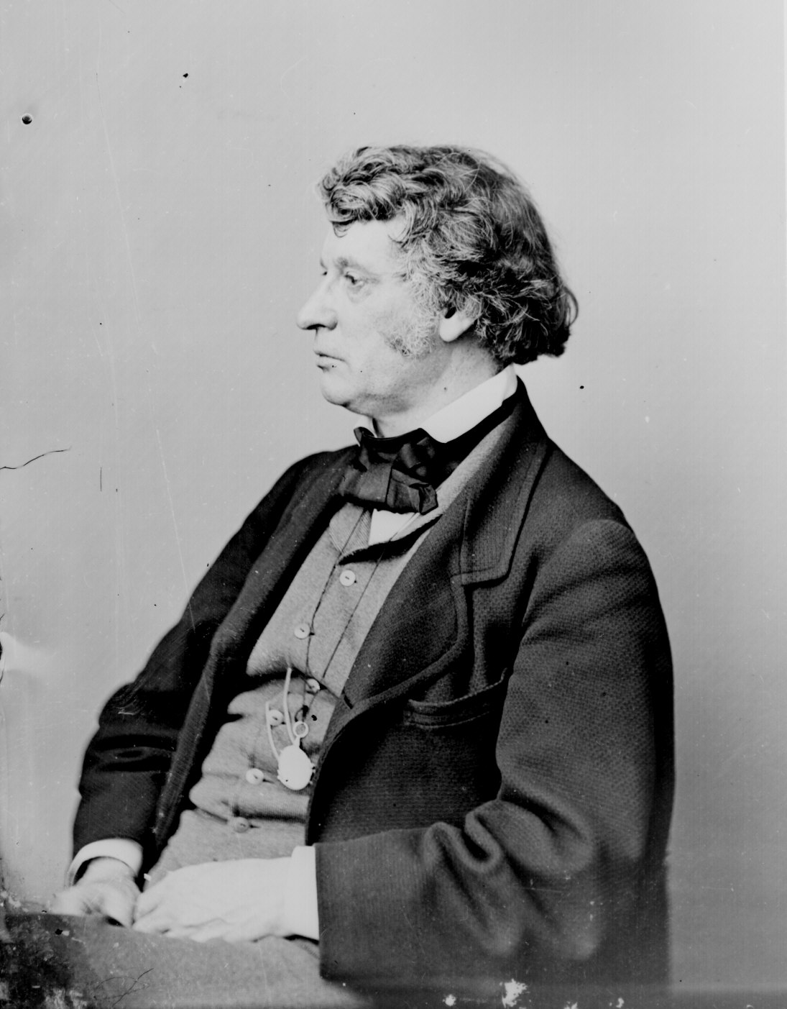
It is the first installment of the great debt which we owe to an enslaved race, and will be recognized as one of the victories of humanity.
Senator Charles Sumner
on the
Immediate Compensated Emancipation Act
signed April 16, 1862

Slide 41
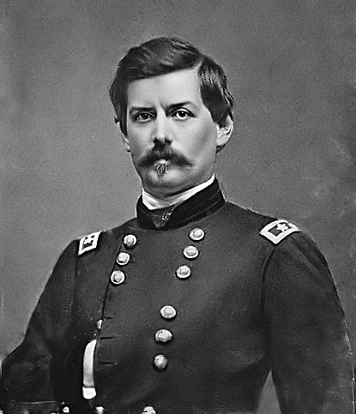
General George McClellan

Slide 42
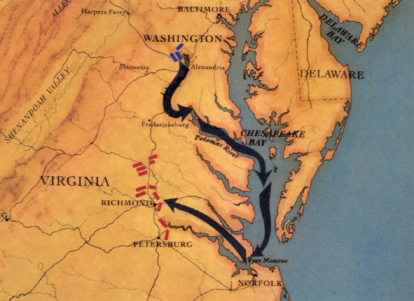

Slide 43
Union Successes by the June 19, 1862:
Occupation of New Orleans, LA
Occupation of Northeastern North Carolina
Occupation of Memphis, TN
Occupation of Nashville, TN
Occupation of Sea Islands, SC
Occupation of Huntsville, AL

Slide 44
An Act to secure Freedom to all Persons within the Territories of the United States.
Be it enacted by the Senate and House of Representatives of the United States of America in Congress assembled, That from and after the passage of this act there shall be neither slavery nor involuntary servitude in any of the Territories of the United States now existing, or which may at any time hereafter be formed or acquired by the United States, otherwise than in punishment of crimes whereof the party shall have been duly convicted.
APPROVED, June 19, 1862.

Slide 46
Militia Act of 1862
SEC. 12. And be it further enacted, That the President be, and he is hereby, authorized to receive into the service of the United States, for the purpose of …performing camp service or any other labor, or any military or naval service for which they may be found competent, persons of African descent, and such persons shall be enrolled and organized under such regulations, not inconsistent with the Constitution and laws, as the President may prescribe.

Slide 47
Militia Act of 1862
SEC. 13. And be it further enacted, That when any man or boy of African descent, who by the laws of any State shall owe service or labor to any person who, during the present rebellion, has levied war or has borne arms against the United States, or adhered to their enemies by giving them aid and comfort, shall render any such service as is provided for in this act, he, his mother and his wife and children, shall forever thereafter be free, any law, usage, or custom whatsoever to the contrary notwithstanding: Provided, That the mother, wife and children of such man or boy of African descent shall not be made free by the operation of this act except where such mother, wife or children owe service or labor to some person who, during the present rebellion, has borne arms against the United States or adhered to their enemies by giving them aid and comfort.

Slide 48
Second Confiscation Act
SEC. 6. And be it further enacted, That if any person within any State or Territory of the United States, other than those named as aforesaid, after the passage of this act, being engaged in armed rebellion against the government of the United States, or aiding or abetting such rebellion, shall not, within sixty days after public warning and proclamation duly given and made by the President of the United States, cease to aid, countenance, and abet such rebellion, and return to his allegiance to the United States, all the estate and property, moneys, stocks, and credits of such person shall be liable to seizure as aforesaid, and it shall be the duty of the President to seize and use them as aforesaid or the proceeds thereof.

Slide 49
Second Confiscation Act
SEC. 9. And be it further enacted, That all slaves of persons who shall hereafter be engaged in rebellion against the government of the United States, or who shall in any way give aid or comfort thereto, escaping from such persons and taking refuge within the lines of the army; and all slaves captured from such persons or deserted by them and coming under the control of the government of the United States; and all slaves of such person found on [or] being within any place occupied by rebel forces and afterwards occupied by the forces of the United States, shall be deemed captives of war, and shall be forever free of their servitude, and not again held as slaves.

Slide 50
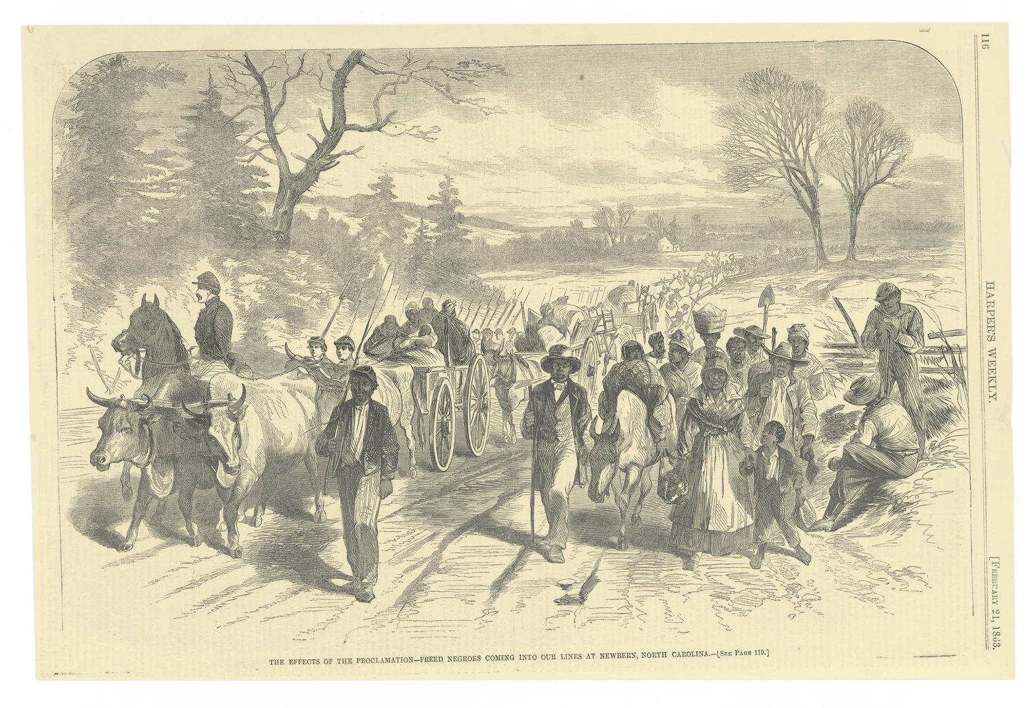

Slide 52
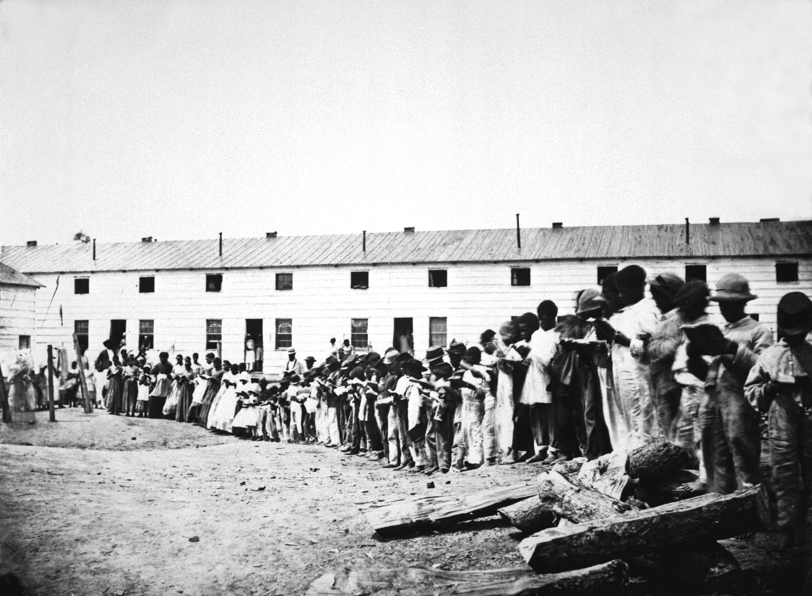

Slide 53
We are able sir, to command all the effective black men, as agents, in the United States.
Major Martin R. Delany

Slide 54
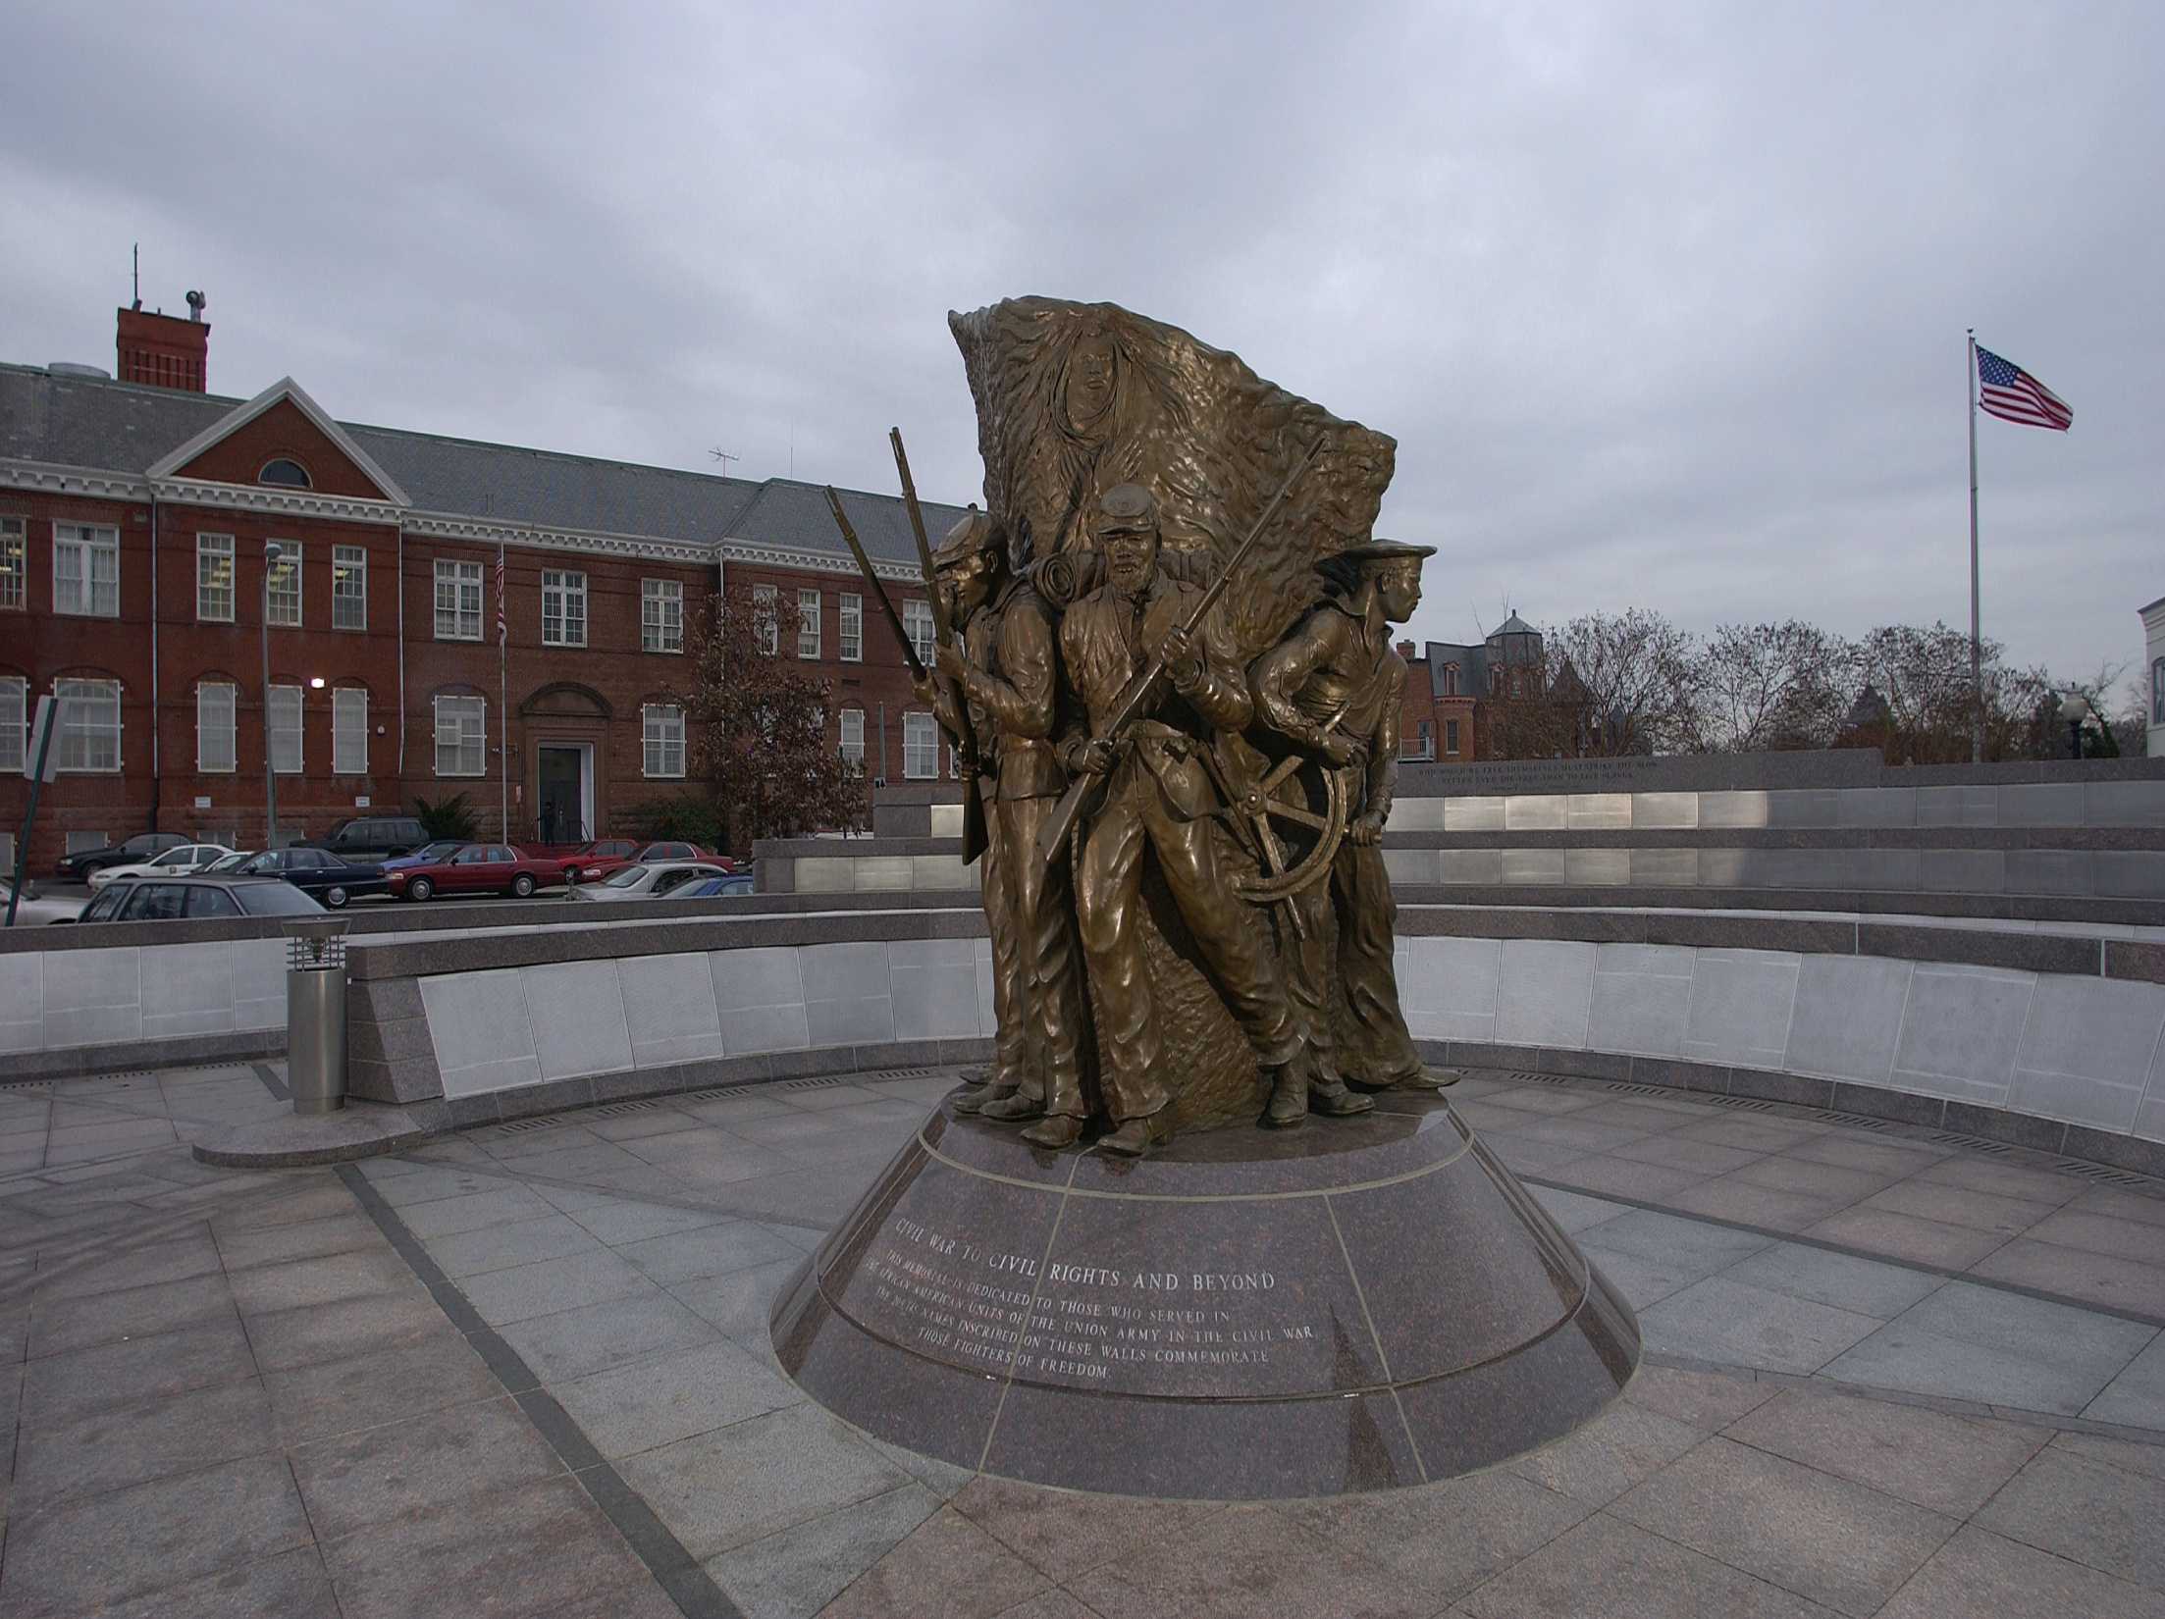
A Glorious March to Liberty
Hari Jones, Curator, African American Civil War Museum

Slide 55
Sources for Your Classroom
Library of Congress: A Century of Law Making
http://memory.loc.gov/ammem/amlaw/
Harper’s Weekly articles from 1861-1865
http://www.sonofthesouth.net
Freedmen and Southern Society Project
http://www.history.umd.edu/Freedmen/chronol.htm

Slide 56
