Slide 1
A New Home for Liberty
Human Rights, Slavery, and the Creation of West Virginia

Slide 2
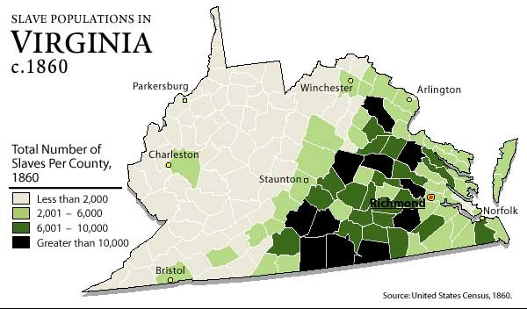

Slide 3
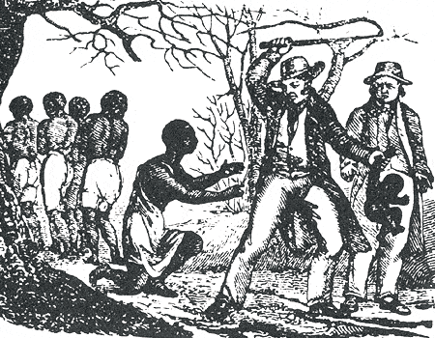

Slide 4
The Ruffner Pamphlet
“We have now seen how slavery, when in full operation, first checks, and then stops the growth of population; and finally turns it into a decline. We have seen also that slavery… hangs like a dead weight upon a country… Slavery is pernicious to the welfare of West Virginia.”
Henry Ruffner

Slide 5
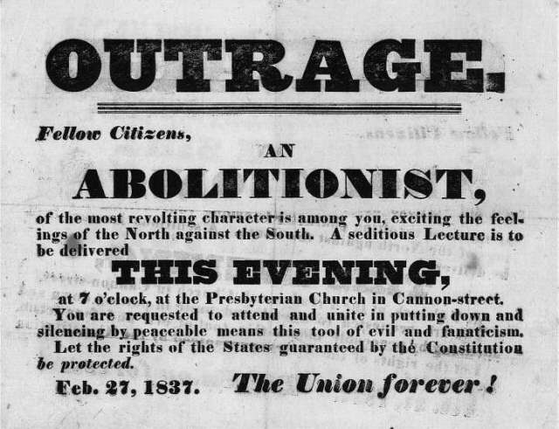

Slide 6
The Impending Crisis of the South
“Heaven forbid that a desperate faction of slaveholding criminals should succeed in their infamous endeavors to quench the spirit of liberty. [The day will come when] the dark clouds of slavery, error and ignorance shall have passed away, [and] the freemen of the South will learn the glorious truth"
Hinton Rowan Helper

Slide 8
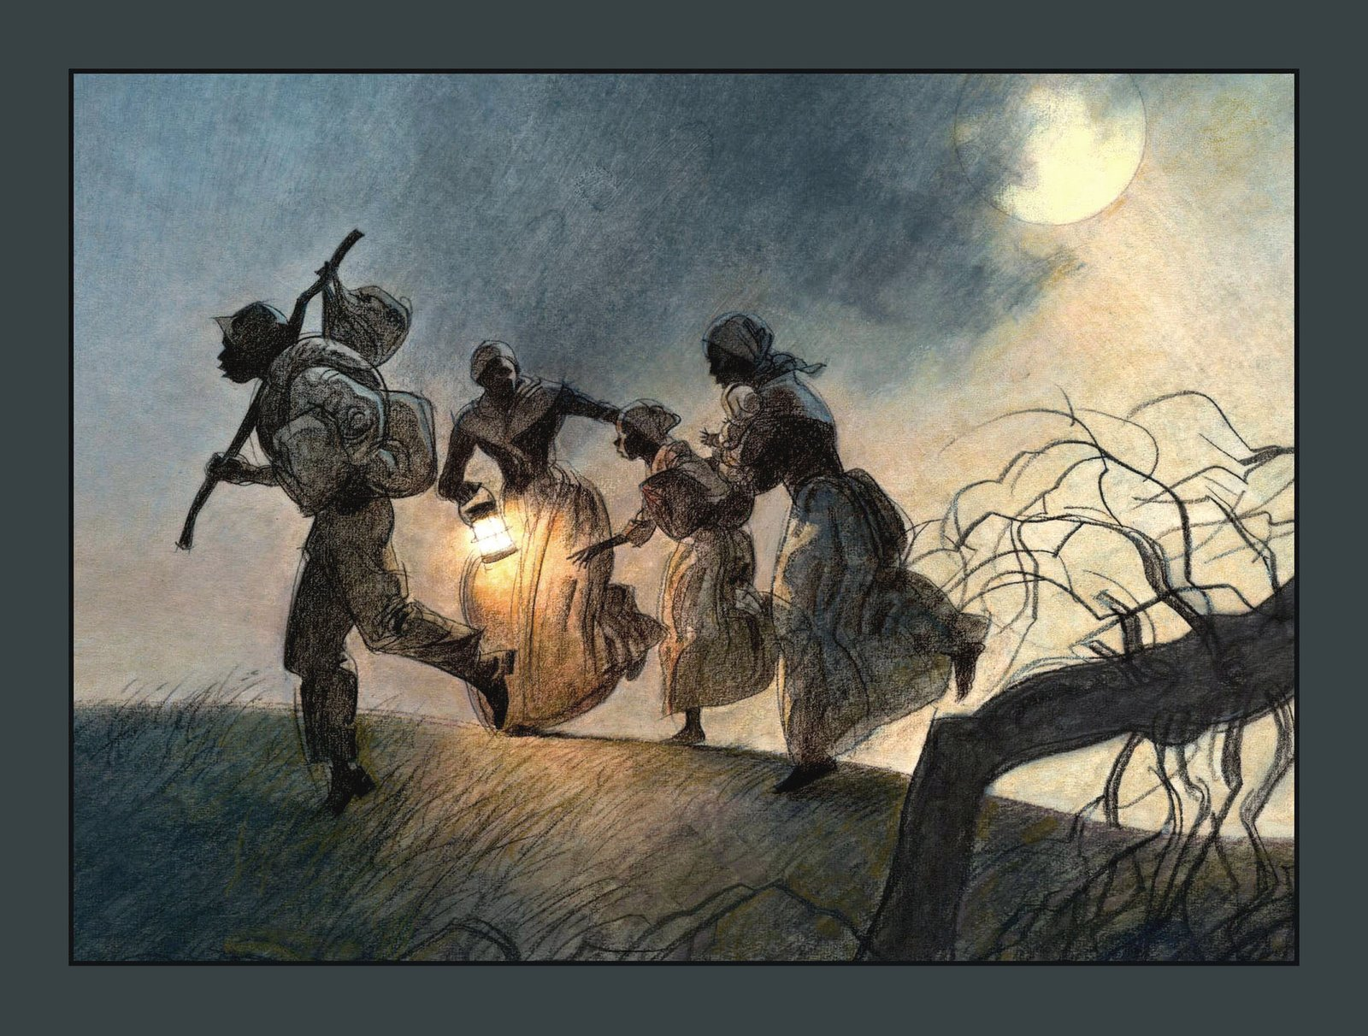

Slide 9
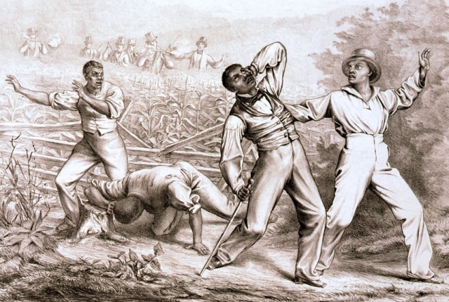

Slide 10
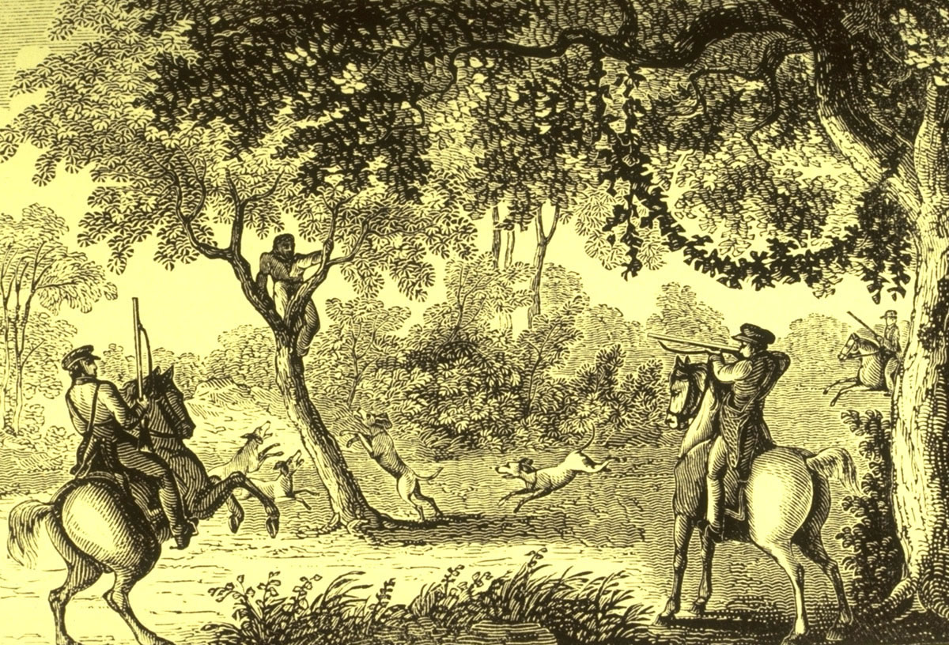

Slide 11
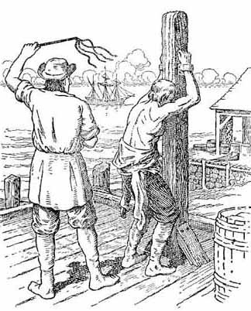

Slide 13
Mr. Hagar
“Negro slavery is the origin and foundation of our national troubles, and the cause of the terrible rebellion in our midst, that is seeking to overthrow our government; and slavery is incompatible with the Word of God, and detrimental to the interests of a free people, as well as a wrong to the slaves themselves.”

Slide 14
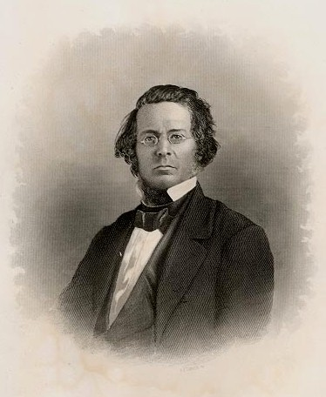
Gordon Battelle

Slide 15
“I congratulate this house and the country on the vote just taken to table the resolution proposed by Mr. Battelle. If nothing more is said about slavery here, it will do more than anything this house can do to cause all opposition to this Constitution and this new State to cease. And I ask my friend from Ohio, Mr. Battelle, never to mention slavery here again.”
Mr. Raymond, Wheeling Convention, February 13, 1862

Slide 16
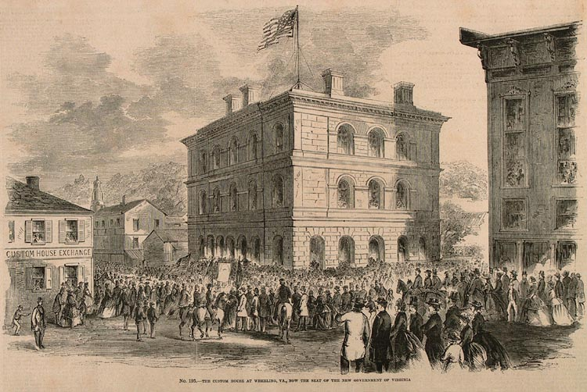
Independence Hall
Location of the Wheeling Conventions

Slide 17
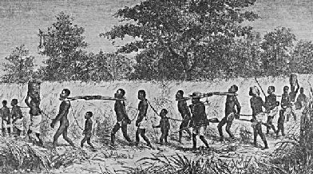
“The injuries which slavery inflicts upon our own people are manifold and obvious. It practically aims to enslave not merely another race, but our own race. It inserts in its bill of rights some very high sounding phrases securing the freedom of speech; and then puts a lock on every man’s mouth and a seal on every man’s lips who will not shout for and swear by the divinity of the system.”

Slide 19
Fredrick Douglass
“Who would be free themselves must strike the blow. Liberty won by white men would lose half its luster. This is the sentiment of every brave colored man amongst us. There is no time to delay. Better even die free, than to live slaves.”

Slide 20
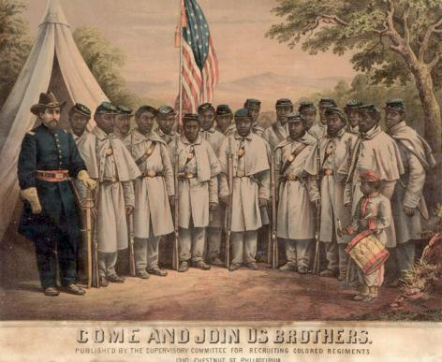
“Believe them not; cowards themselves, they do not wish to have their cowardice shamed by your brave example.”
Fredrick Douglass

Slide 21
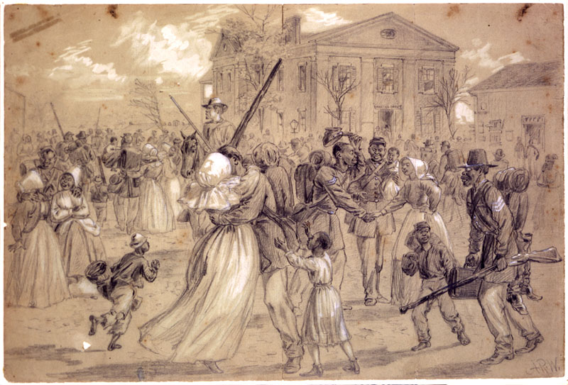

Slide 23
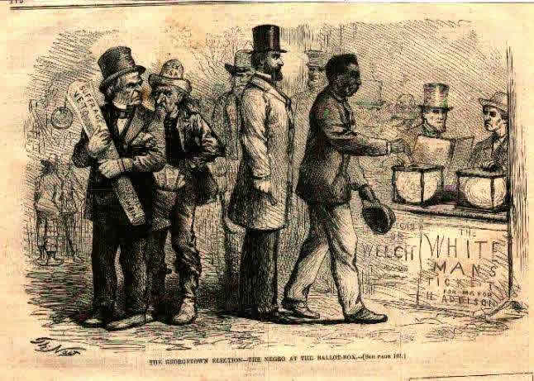

Slide 24
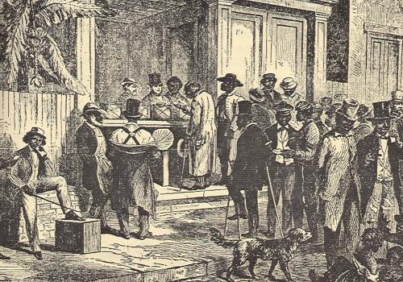

Slide 25
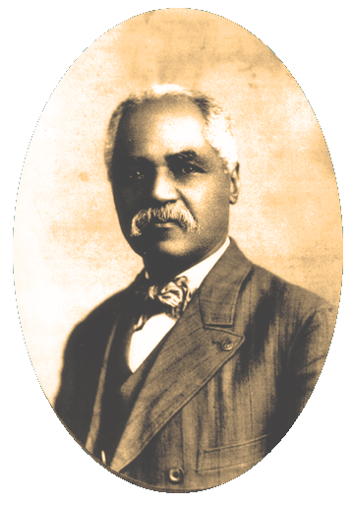
J.R. Clifford

