Slide 1
J.R. Clifford
A Civil Rights Pioneer
West Virginia’s First African American Attorney

Slide 2
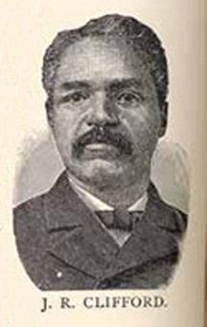
J.R. Clifford was born in 1848 to free black parents in what would later become West Virginia.

Slide 3
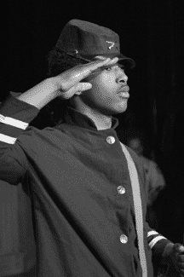
A member of the Union troops, J.R. Clifford was a Civil War veteran.

Slide 4
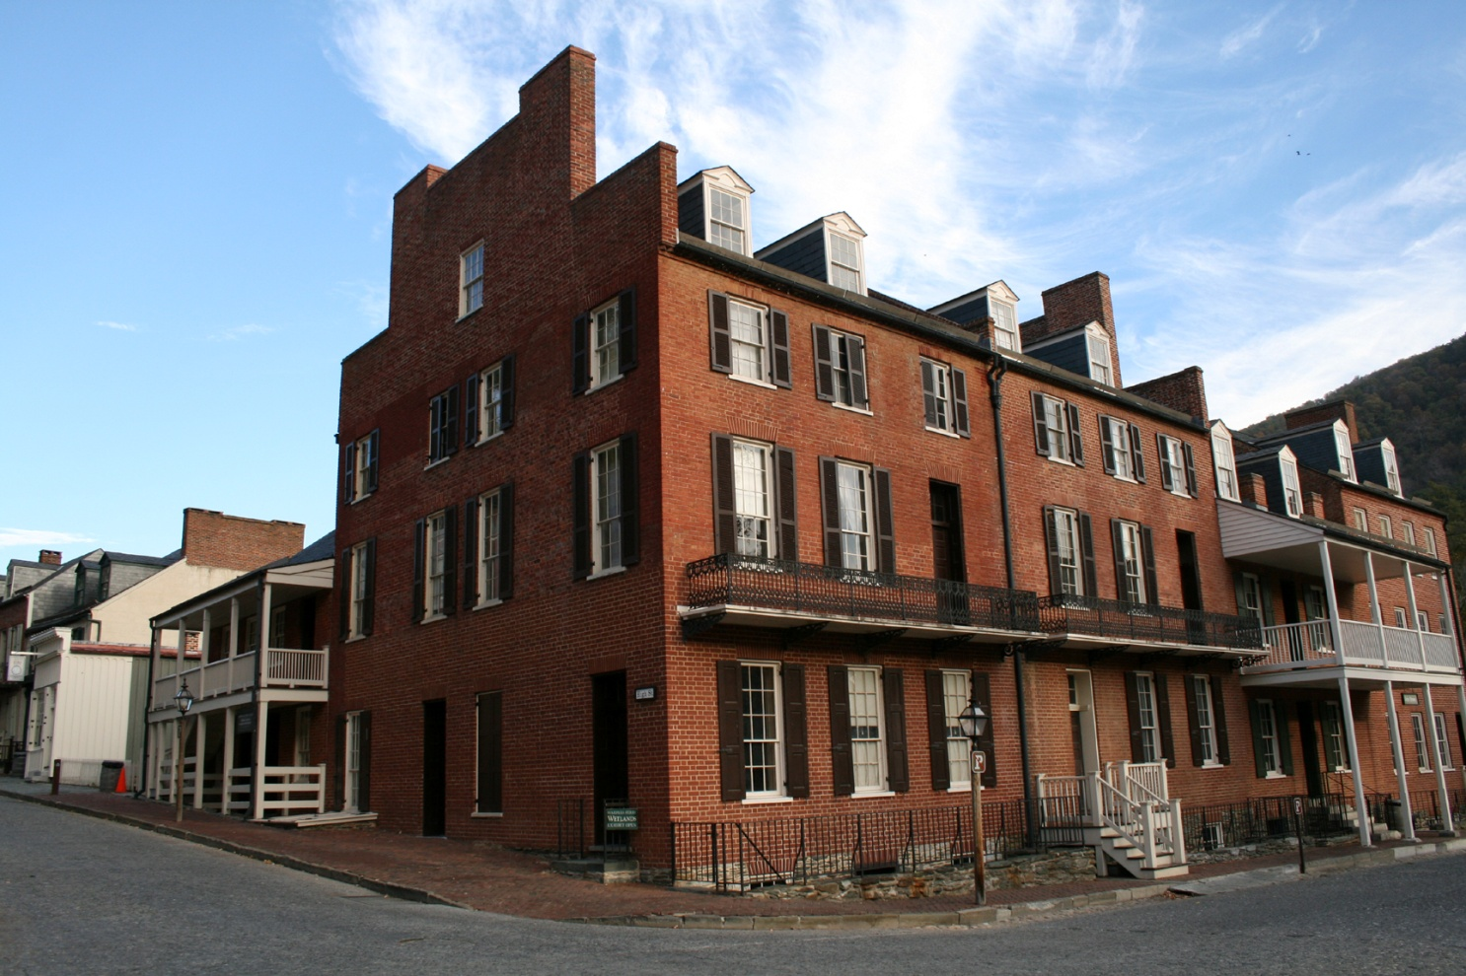
J.R. Clifford got his education at Storer College in Harpers Ferry.

Slide 5
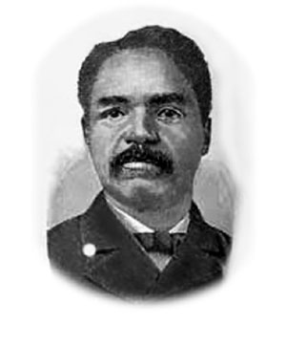
J.R. Clifford was a school teacher and principal. He believed that education was incredibly important for all people, and fought for the fair treatment of all citizens and their right to schooling.

Slide 6
Founder of The Pioneer Press, J.R. Clifford was the editor of West Virginia’s first African American newspaper.

Slide 7
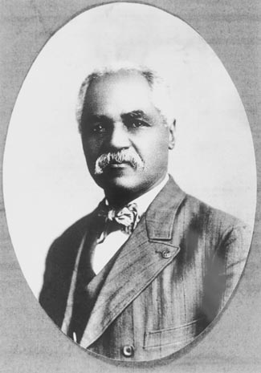
In 1898, J.R. Clifford took the Carrie Williams v. Board of Education case to the West Virginia Supreme Court and won. This meant that all children in West Virginia, regardless of race, deserved the same amount and quality of schooling.

Slide 8
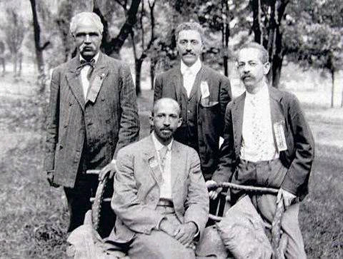
J.R. Clifford worked closely with W.E.B. DuBois attempting to change our nation’s destructive and racist behavior.

Slide 9
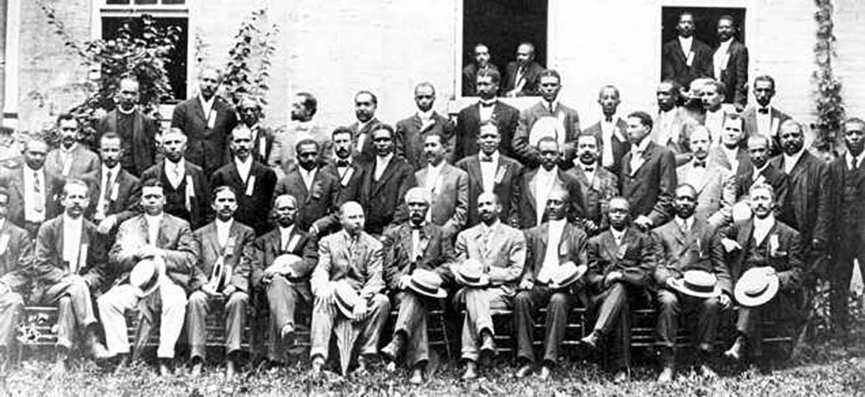
The Niagara Movement was a civil rights group that J.R. Clifford helped W.E.B. DuBois create. This organization eventually began the current-day NAACP.

Slide 10
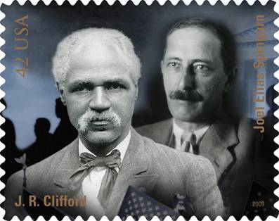
In 2009, J.R. Clifford was selected as one of 12 Civil Rights pioneers to be featured on a United States Postage Stamp.

Slide 11
We work to educate the community on J.R. Clifford’s life, as well as his message of anti-racism and equality for all people.

Slide 12
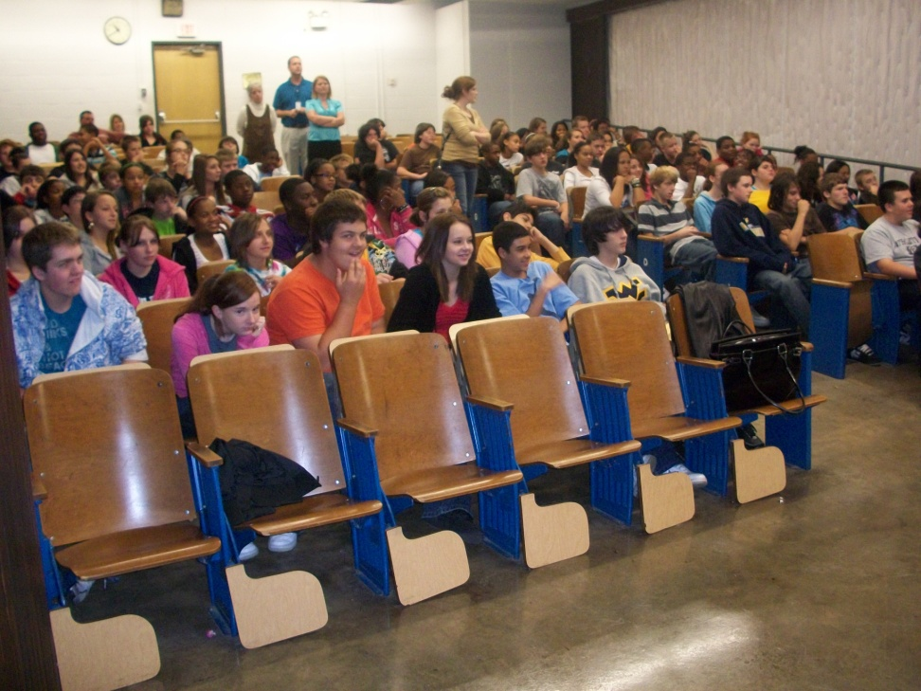
We travel to schools across the state giving presentations on J.R. Clifford’s life in order to help students appreciate an often unheard-of West Virginia hero.

Slide 14
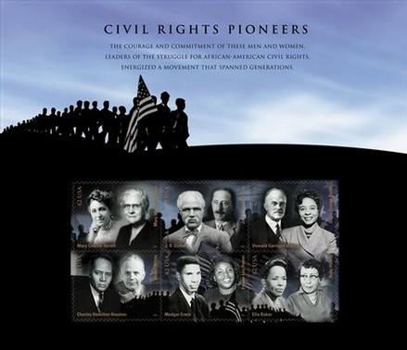

Slide 15
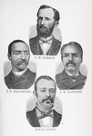

Slide 16
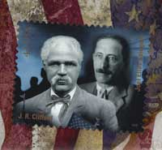

Slide 17
